Slide 1

Baby Name Popularity
By Casey Lindsted

Slide 2
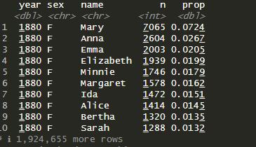
Question: How does demographic change affect baby name popularity?
The dataset I’ve chosen to investigate this question is the babynames dataset.
This dataset sources data from the Social Security Administration. It lists by year the name of every baby born from 1880-2017.
We’ll use this dataset to examine the popularity of particular names as well as general trends in the U.S.

Slide 3

Shiny App:
Code for my Shiny App.

Slide 4

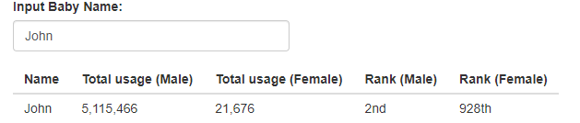
Functionality:
To run my app, all you’ll need are the requisite packages. No data downloads required as the data exists in the packages.
The App starts with a default name in the text input box.
You can enter any name of your choosing. The name is used to filter the dataset, generate summary statistics, and custom visualizations.

Slide 5
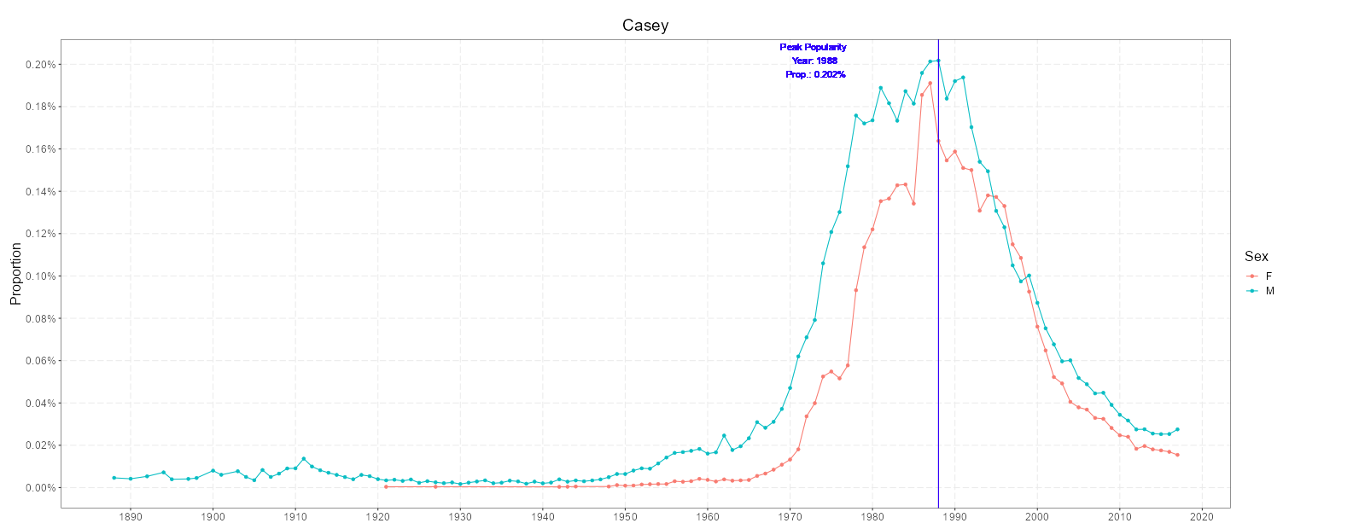
Proportion Graph:
Here I’ve used my own name as an example. On the graph, you’ll see the proportion of babies (both male and female) who were named “Casey” for every year on record.
It also lists the year that the name peaked in popularity as well as its max proportion.

Slide 6
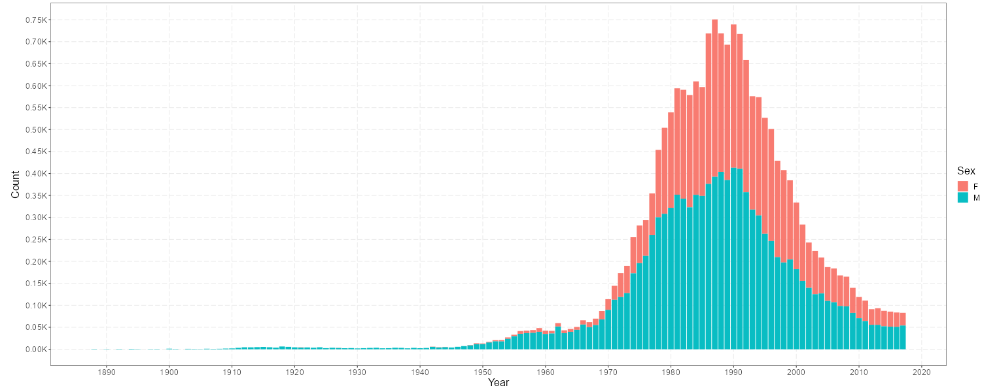
Count Graph:
Likewise, this graph shows the popularity of a name in terms of how many babies were given that name in a particular year.
At first, it seems contradictory that the year the name peaked in popularity (the highest proportion in a year was for males) would feature so many females with that name. However, as we’ll see soon, name popularity is more complicated than you might think and depends on other factors.
Give the name app a try for yourself. I’ve spent a few hours testing it out with family and friends; it’s surprisingly fun.

Slide 7
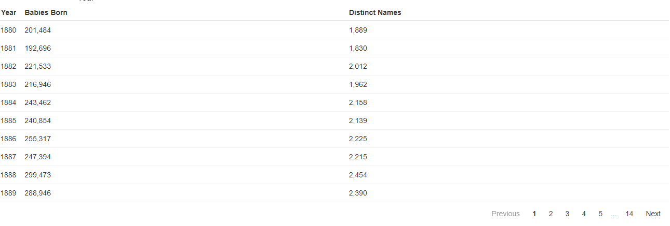
Table:
The next section of the app looks at factors that contribute to name popularity. A reactable lists the number of babies born each year and the number of distinct names. This info is visualized later on.

Slide 8
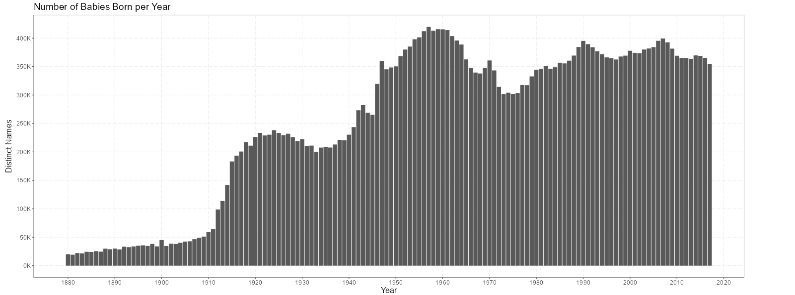
How does population relate to name popularity?
You might assume that the years in which certain baby names reached their highest popularity would be in the years that saw the greatest number of babies born. This graph on my app shows an increase of babies born during the mid-20 century as well as some dips and a slow decline in the 2000’s.

Slide 9
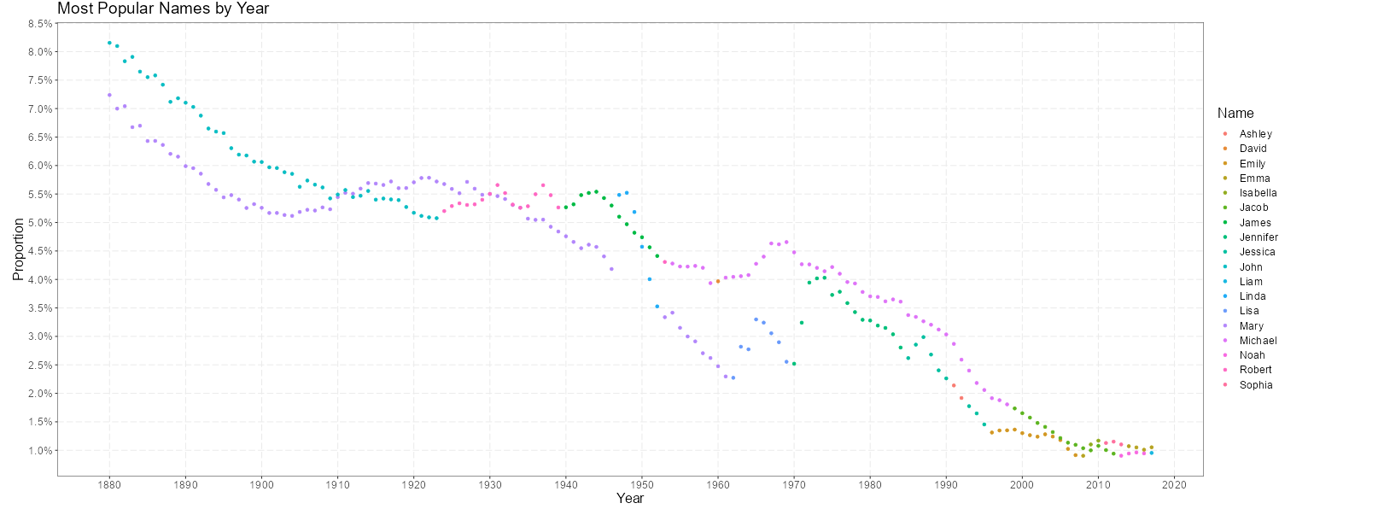
Trends in Baby Name Popularity:
This chart shows the most popular male and female name for each year on record. What do we see? The years with the names highest in popularity are the earliest on record. Why might that be?

Slide 10
What does this mean?
Population is not the deciding factor. Our birth rate is actually down from its peak in the 1960’s, yet our most popular names are scarcely at 1.0% popularity, compared to 8% in 1880.
The next graph explains what’s going on.

Slide 11
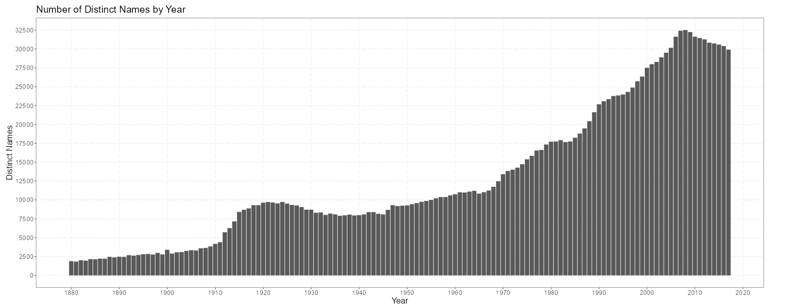
Name variety is key to explaining popularity.
Here we can see that the number of distinct baby names has done virtually nothing but rise until scarcely after 2010. Even during peak population years, the number of distinct names was relatively small compared to post -1980.
Due to a high variety of baby names in recent times, our most popular names scarcely rise above 1.0%.

Slide 12
Conclusion
Demographic change doesn’t influence baby name popularity so much as cultural change. While you can have a million babies born with the same name, if the population is sufficiently large enough and the number of other baby names is sufficiently varied, it won’t breach the threshold of being “popular”.

